Slide 1
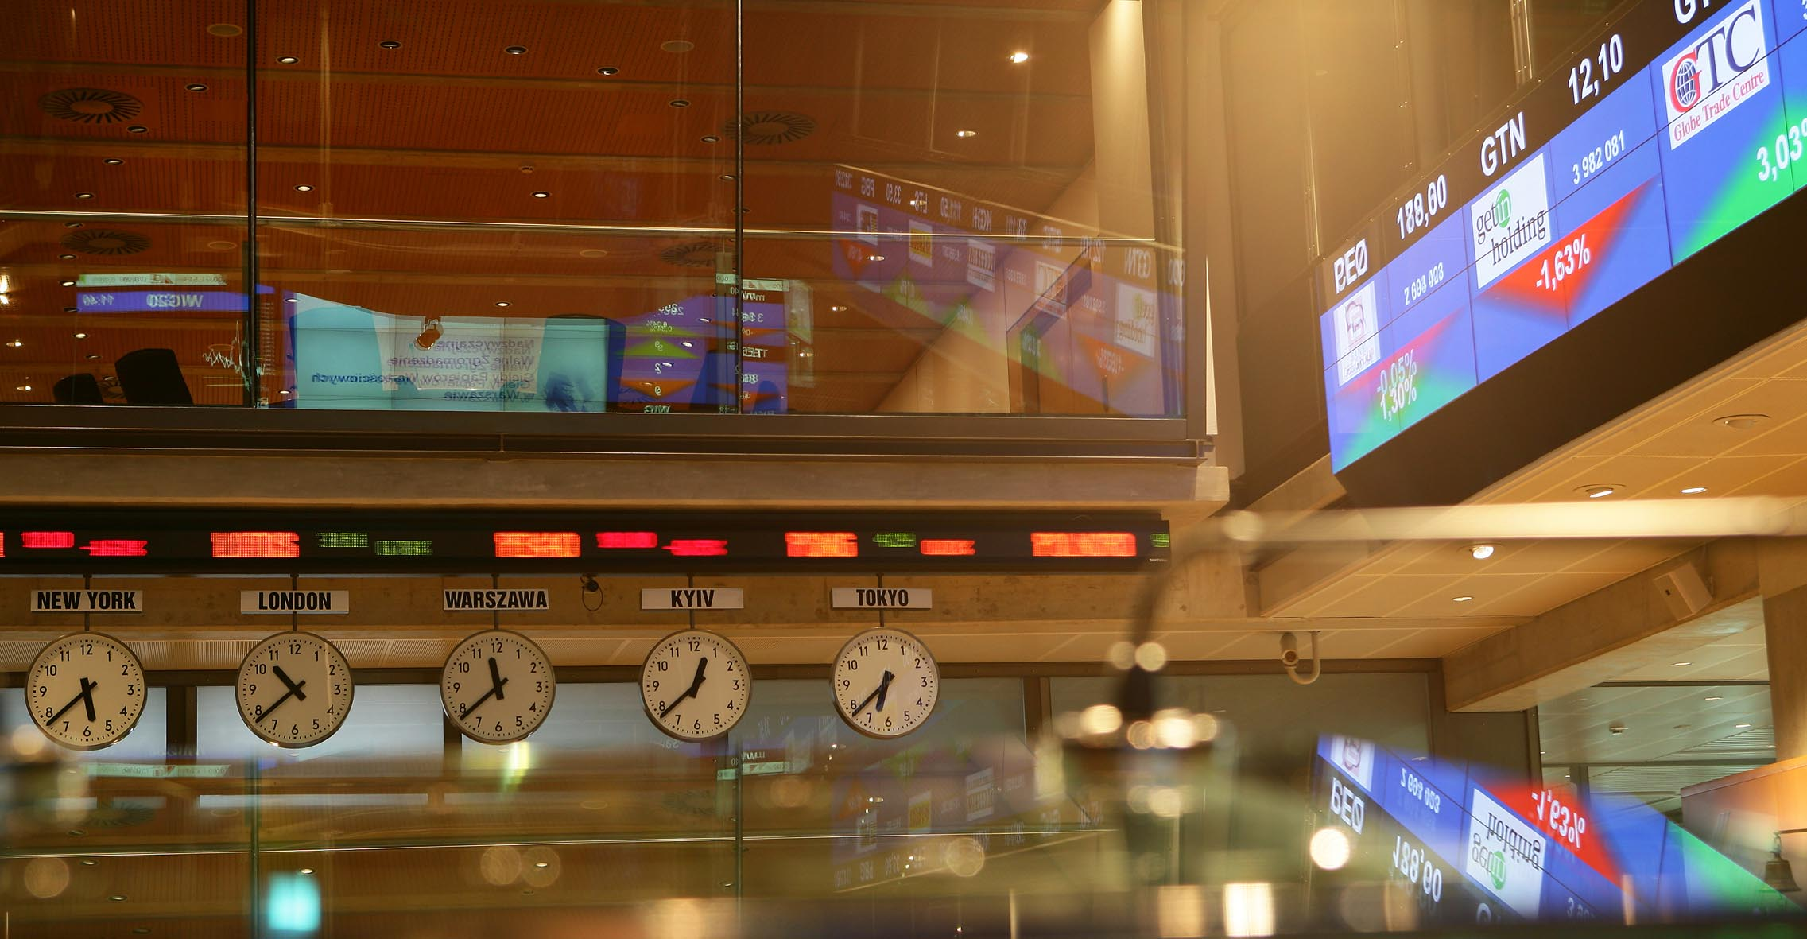



OVERVIEW OF THE POLISH CAPITAL MARKET chances and opportunities NOVEMBER 2013

Slide 2

Poland’s Key Position in the enlarged EU
EU GDP (%) | 2008 | 2009 | 2010 | 2011 | 2012 | 2013f | 2014f | 2008-2012 accumulated GDP
Poland | 5,1 | 1,6 | 3,9 | 4,5 | 1,9 | 1,1 | 2,2 | 18,1
Lithuania | 2,9 | -14,8 | 1,5 | 5,9 | 3,7 | 3,1 | 3,6 | -2,3
Latvia | -3,3 | -17,7 | -0,9 | 5,5 | 5,6 | 3,8 | 4,1 | -12,1
Slovakia | 5,8 | -4,9 | 4,4 | 3,2 | 2,0 | 1,0 | 2,8 | 10,6
Estonia | -4,2 | -14,1 | 3,3 | 8,3 | 3,2 | 3,0 | 4,0 | -5,0
Romania | 7,3 | -6,6 | -1,1 | 2,2 | 0,7 | 1,6 | 2,2 | 2,0
Malta | 3,9 | -2,8 | 2,9 | 1,7 | 0,8 | 1,4 | 1,8 | 6,5
Denmark | -0,8 | -5,7 | 1,6 | 1,1 | -0,5 | 0,7 | 1,7 | -4,4
Luxemburg | -0,7 | -4,1 | 2,9 | 1,7 | 0,3 | 0,8 | 1,6 | 0,0
Austria | 1,4 | -3,8 | 2,1 | 2,7 | 0,8 | 0,6 | 1,8 | 3,1
Finland | -8,5 | 0,3 | 3,3 | 2,8 | -0,2 | 0,3 | 1,0 | -2,7
Germany | 1,1 | -5,1 | 4,2 | 3,0 | 0,7 | 0,4 | 1,8 | 3,7
Bulgaria | 6,2 | -5,5 | 0,4 | 1,8 | 0,8 | 0,9 | 1,7 | 3,4
Ireland | -2,1 | -5,5 | -0,8 | 1,4 | 0,9 | 1,1 | 2,2 | -6,1
France | -0,1 | -3,1 | 1,7 | 2,0 | 0,0 | -0,1 | 1,1 | 0,4
UK | -1,0 | -4,0 | 1,8 | 1,0 | 0,3 | 0,6 | 1,7 | -2,0
Sweden | -0,6 | -5,0 | 6,6 | 3,7 | 0,7 | 1,5 | 2,5 | 5,1
EU (27 countries) | 0,3 | -4,3 | 2,1 | 1,6 | -0,3 | -0,1 | 1,4 | -0,7
Belgium | 1,0 | -2,8 | 2,4 | 1,8 | -0,3 | 0,0 | 1,2 | 2,0
Czech Republic | 3,1 | -4,5 | 2,5 | 1,9 | -1,3 | -0,4 | 1,6 | 1,5
Euro area (17 countries) | 0,4 | -4,4 | 2,0 | 1,5 | -0,6 | -0.4 | 1,2 | -1,2
Hungary | 0,9 | -6,8 | 1,3 | 1,6 | -1,7 | 0,2 | 1,4 | -4,9
Cyprus | 3,6 | -1,9 | 1,3 | 0,5 | -2,4 | -8,7 | -3,9 | 1,0
Netherlands | 1,8 | -3,7 | 1,6 | 1,0 | -1,0 | -0,8 | 0,9 | -0,4
Italy | -1,2 | -5,5 | 1,7 | 0,4 | -2,4 | -1,3 | 0,7 | -7,0
Slovenia | 3,4 | -7,8 | 1,2 | 0,6 | -2,3 | -2,0 | -0,1 | -5,2
Spain | 0,9 | -3,7 | -0,3 | 0,4 | -1,4 | -1,5 | 0,9 | -4,1
Portugal | 0,0 | -2,9 | 1,9 | -1,6 | -3,2 | -2,3 | 0,6 | -5,8
Romania | 7,3 | -6,6 | -1,1 | 2,2 | 0,7 | 1,6 | 2,2 | 2,0
Economy:
The largest and most populated new (i.e. accession post 2004) EU member State (population c.a. 38 million)
Poland’s GDP accounts for c.a. 38% of the new EU 12 members’ GDP
Key statistics:
GDP growth in 2010: 3.9%
GDP growth in 2011: 4.3%
GDP growth in 2012: 1.9%
GDP growth forecast in 2013: 1.1%
Polish government GDP growth forecast in 2014: 2,5%
2008 - 2012 accumulated GDP: 18.1%
Ratings
A2 Stable by Moody’s
A- Stable by S&P
A- Stable by Fitch
Source: Ministry of Finance, Polish Central Statistical Office, Eurostat, EBOR.

Slide 3
WSE- broad and diversified investor base
WSE successfully attracts new domestic and remote trading members. These are mainly local investment firms, international investments banks and regional financial intermediaries. With recent launch of the UTP trading system, WSE has opened up to new groups of investors, including global investment firms active in algorithmic trading and proprietary trading firms.
Equity trading - structure of investors in H1 2013
Derivatives trading - structure of investors in H1 2013
Largest institutional investment pool in the CEE with high allocation in domestic equities
AUM Pension Funds - EUR 69 bn (as of Sept. 2013)
AUM Investment Funds - EUR 41 bn (as of Sept. 2013)
Broad retail investor base with active interest in capital markets investments
At the end of 2012, the number of individual securities accounts registered with the Central Securities Depository of Poland (KDPW) was over 1.5 million.

Slide 4
Warsaw Stock Exchange Group
Derivatives market
Cash market (bonds)
Market data and indices
Commodities
Post-trading services
Cash market
(equities and other)
22 years of functioning
Active IPO market
Leading stock exchange in the CEE region
Attractive to the foreign investors and foreign issuers
Shares
Debt Instruments
Structured Products
Warrants
Futures
ETFs
Investment
Certificates
Options
Shares of 446 companies, including 46 foreign on WSE Main List (regulated market)
Shares of 445 companies, including 9 foreign, on NewConnect (WSE alternative market for SMEs)
Derivatives: futures contracts on various underlyings (i.e. indices, single stocks and currencies), options on WIG20 index
ETP segment covering ETF’s, warrants, structured certificates (including knock-out certificates and newly introduced factor certificates) and structured bonds
Debt instruments (including treasury bonds, corporate, municipal bonds, mortgage backed bonds)

Slide 5



WSE – one of the fastest developing
market in Europe
The Warsaw Stock Exchange is among the most dynamic European markets, holding unquestionable leadership in Central and Eastern Europe in terms of: market capitalisation, trading value and the number of new trading members and issuers.
Exchanges’ share in capitalisation
of shares in CEE¹ region, 2012
WSE share of exchanges in trading
in shares in CEE¹ region, 2012
Main Market - equities
# domestic companies
Main Market- equities
# foreign companies
NewConnect
# small caps companies
Catalyst²
# bonds issuers
WSE’s share in equities trading in CEE¹ in June was record-high at 65%
According to the IPO Watch Europe report, WSE ranked 2nd in Europe by the number of IPOs in H1 2013 (31 IPOs representing 26% of all IPOs in Europe) and 7th by the value of IPOs (EUR 325 mn)
¹ Including: WSE, CEESEG Group, Bulgarian, Romanian and Slovak stock exchanges, source: FESE
² Only non-Treasury bonds

Slide 6
WSE in Europe
Growth rate of the value of trading on European exchanges,
Q1-Q3 2013 versus Q1-Q3 2012¹
Value of equities trading on WSE in Q1-Q3 2013 increased by 16.1% YoY
Value of trading in CEE in Q1-Q3 2013 increased by 9.7% YoY while the value of trading on all European exchanges decreased by 2.0% YoY
WSE’s share in the value of equities trading in CEE³ was 59.3% year to date
202%
WSE’s shares in equities trading in CEE³
EUR bn
²
¹ Source: FESE; session trades in EUR
² Since 20.05.2013, BATS Chi-X Europe operates in Europe as a licensed exchange
³ including: WSE, CEESEG Group, Bulgarian, Romanian and Slovak exchanges, source: FESE

Slide 7
WSE derivatives market – brand new opportunities under your fingertips
Index futures trading volume in Europe (H1 2013; m)
Derivatives trading volume (m)¹
Structure of derivatives trading volume¹
The Warsaw derivatives market is the most significant market of this kind among CEE exchanges. The WSE closed 2012 on the 4th position in Europe in terms of trading volume in index futures. Index futures have been the most popular derivatives for a number of years. WIG index futures were the most traded futures contracts on the WSE.
Q3 2013
3.43 m
¹ as of 1 May 2012, the volume of trading in fx futures is calculated on the basis of a trading unit equal to 1,000 contracts (previously: 10,000 contracts), therefore derivatives turnover volume since that date arenot fully comparable with data in previous periods

Slide 8

Growing number of foreign companies listed on WSE
Countries of origin of foreign companies listed on the WSE
WSE-listed company with Israeli capital:
ATLAS ESTATES
CINEMA CITY
PLAZA CENTERS
RONSON EUROPE
GLOBE TRADE CENTRE
2013 debuts:
INTERNATIONAL PERSONAL FINANCE (UK)
IMMOFINANZ AG (AUSTRIA)
PHOTON ENERGY N.V. (NETHERLANDS)
AVIAAM LEASING (LITHUANIA)
PEIXIN INT. GROUP (REPBLIC OF CHINA)
55 foreign companies listed (46 on WSE Main List and 9 on NewConnect)
26 foreign companies joined the WSE-listed companies’ family since the beginning of 2011 (both WSE equities markets).
Source: WSE, YTD.

Slide 9
Attractive venue for issuers
WSE Main List: Breakdown by sector
WSE remained Europe’s #2 by the number of IPOs in Q3 2013
NewConnect: Breakdown by sector
There were 10 IPOs on Warsaw Stock Exchange in Q3 2013 (2 IPOs on the WSE Main Market and 8 IPOs on NewConnect).
The share of WSE in the total number of all IPOs in Europe was 19%.
The London Stock Exchange remained the leader by the number of IPOs.
The aggregate value of IPOs on WSE in Q3 2013 was EUR 15 million, which ranked WSE #7 in Europe by the value of initial public offerings.
Source: PwC IPO Watch Europe report

Slide 10

Non-Treasury bond market – Catalyst
Growth of Poland’s non-Treasury debt market
(value of issue at the end of a period, PLN bn)
Catalyst (non-Treasury debt)
Over the four years of Catalyst, as at the end of Q3 2013:
Value of issues listed on Catalyst increased by more than 10 times to PLN 59.2 bn;
Number of non-Treasury bond issues increased by more than 10 times to 407 listed series
Source: Fitch Polska, WSE

Slide 11

WSE Listing Requirements – stock market
General listing requirements on the WSE Main List:
Appropriate public information document prepared and approved by relevant supervision authority in EU („single passport rule”), unless such information document is not required,
No bankruptcy or liquidation proceedings underway with respect to the issuer,
Transferability not restricted,
Value of shares/equity no less than PLN equivalent of EUR 15 million,
Financial statements together with auditor’s opinions for at least past three consecutive financial years published (IFRS),
Appropriate dispersion of shares.
General listing requirements on the NewConnect:
Preparation of an information document,
No bankruptcy or liquidation proceedings underway with respect to the issuer,
Transferability not restricted,
The issuer’s equity is at least PLN 500,000,
Nominal value of share - min. 0,10 PLN,
Appropriate dispersion of shares,
Cooperation with an Authorized Adviser and Market Animator.

Slide 12











WSE – entry ticket for full access to capital markets
Why Warsaw Stock Exchange?
Favorable macroeconomic conditions – forecast of Polish GDP growth in 2013 equals 1.8 %, while EU27 average is 0.4%
Presence on the largest market in the CEE Region
Access to wide base of large institutional and retail investors
Recognition by international financial community operating on the WSE
Receptive to foreign issuers – large companies and SMEs
Availability of other means of financing – debt instruments (Catalyst)
32 local + 26 foreign brokerage houses operating on the WSE (exchange members) from 11 countries
 | Credit Suisse Securities (Europe) Ltd, JP Morgan Securities Ltd, Goldman Sachs International, HSBC BANK, Merrill Lynch International, Liquidnet Europe, UBS Ltd, Wedbush Europe Ltd., Morgan Stanley & Co International Plc, VTB Capital Plc |  | Raiffeisen Centrobank AG
 |  |  | IP Intercapital Markets AD
 | Concorde Securities Ltd, Equilor Investment |  | Renaissance Securities, Dragon Capital, SIB (Cyprus) Ltd.
 | ING Bank NV |  | Wood & Company, Cyrrus, Fio Banka
 | Orion Securities |  | Societe Generale SA, BNP Paribas Arbitrage SNC
 | Neonet Securities AB |  | UniCredit Bank AG

Slide 13
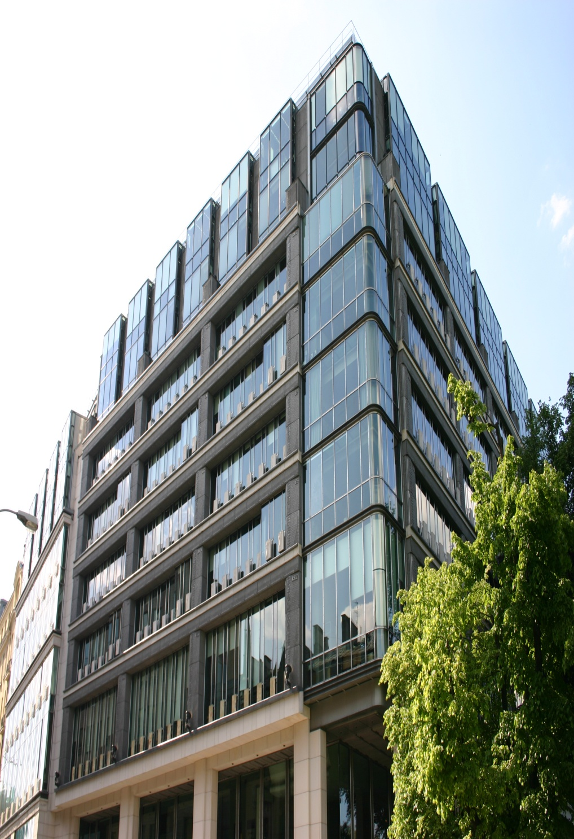
Contact
Warsaw Stock Exchange ul. Książęca 4, 00-498 Warsaw, Poland
tel. (48) 22 628 32 32 www.wse.com.pl
gpw@gpw.pl
Disclaimer
This presentation has been prepared by Giełda Papierów Wartościowych w Warszawie S.A. (“Warsaw Stock Exchange”, “WSE” or “Company”) for its shareholders, analysts, and other contractors. This presentation has been prepared solely for information and is not an offer to buy or sell or a solicitation of an offer to buy or sell any securities or instruments. This presentation is not an investment recommendation or an offer to provide any services.
All efforts have been made to present the data in this presentation; however, some data are derived from external sources and have not been independently verified. No warranty or representation can be given that information in this presentation is exhaustive or true.
The WSE has no liability for any decisions made on the basis of any information or opinion in this presentation. The WSE informs that in order to obtain information about the Company reference should be made to periodic and current reports published in compliance with applicable provisions of Polish legislation.

